Slide 1
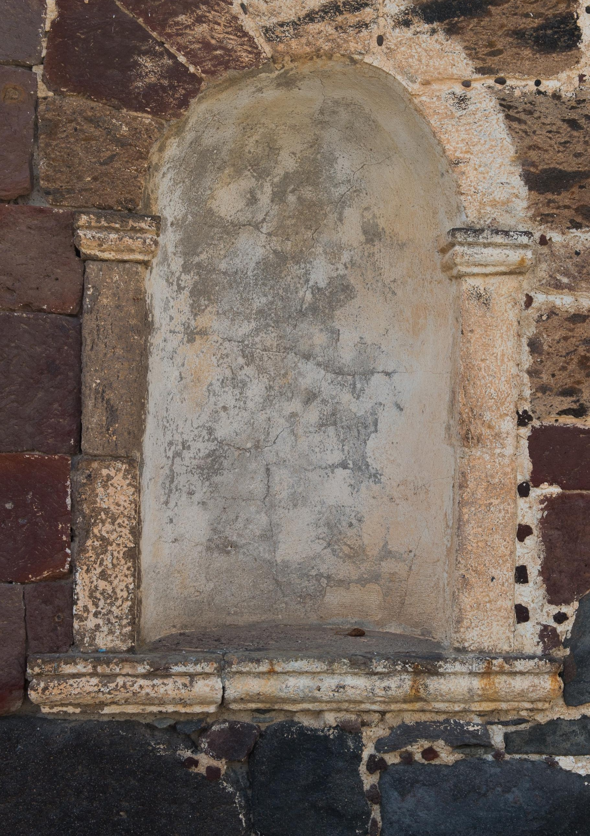
2024
R E N T SY M P O S I O N
MΕGALOCHORI - SANTORINI

Slide 2
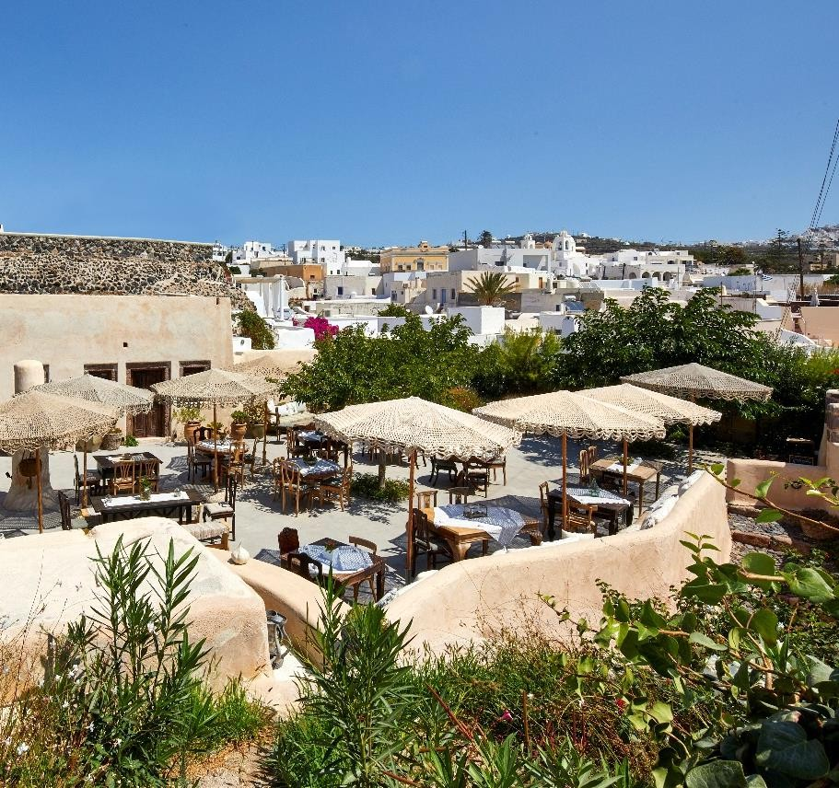
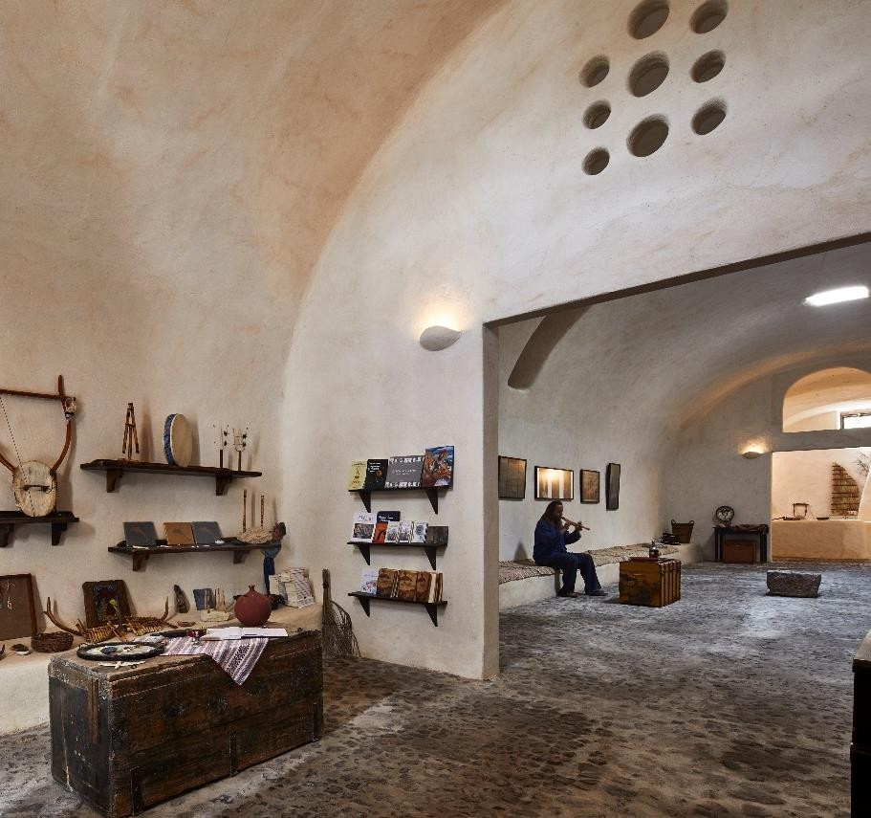
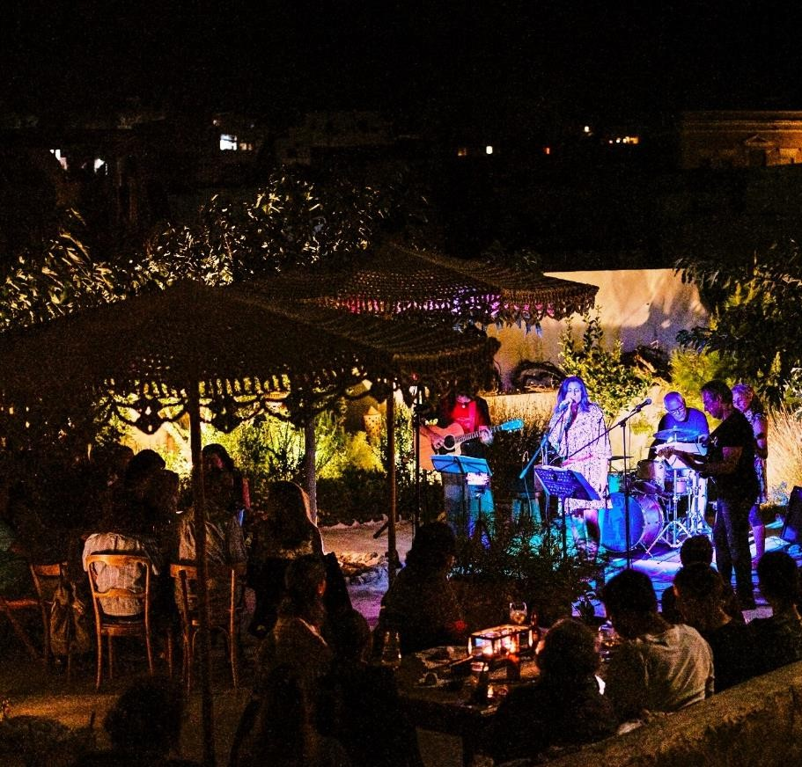
P R I V A T E E V E N T S
The beautiful outdoor courtyard
and majestic internal chamber are
available to rent for select inspired and intimate occasions. Ideal for
hosting a tailor made themed dinner, educational lectures,
business conferences and more.
‘‘ E X C E L L E N T P R E S E N T A T I O N O F G R E E K
C U L T U R E A N D M U S I C . ’’
D E T A I L S
Capacity
Seated 60 guests in the garden courtyard
Seated 50 guests in the Saliveros Chamber
April through October or upon special request
S T A N D A R D F A C I L I T I E S
Wi - Fi internet
Projector and Screen
Sound System
Microphones / Stands
Other facilities available on
demand
U P O N R E Q U E S T
Catering
Entertainment Options

